Slide 1
Greenwich Library
10 WAYS TO PROTECT YOURSELF ONLINE
Copyright 2018, Rich Malloy
Notes:
Thank the library for inviting you.

Slide 2
Who Is Rich Malloy?
MBA, UConn
Computer Consultant
Former College Professor
IT Dept., Norwalk Community College
Former Magazine Editor
Editor-in-Chief, Mobile Computing magazine
Executive Editor, Byte magazine
Contact: 203-912-8268, malloy@techhelptoday.com

Slide 3
Lecture Description
There are literally dozens of ways for Internet hackers to break into your accounts or your computer – and the list keeps growing.
Find out about the ten vital security practices we all must employ to protect our personal information and our finances.

Slide 4
Computer Security
Security versus Convenience
You can’t have both
30+ Ways to Protect Yourself and Your Data
These are just the Top Ten

Slide 5
10

Slide 6
Which Is More Secure?
Your PC
Your Cellphone

Slide 7
If you need to open any strange email ...
Open it on your cellphone

Slide 8
10. USE MOBILE DEVICES

Slide 9
9

Slide 10
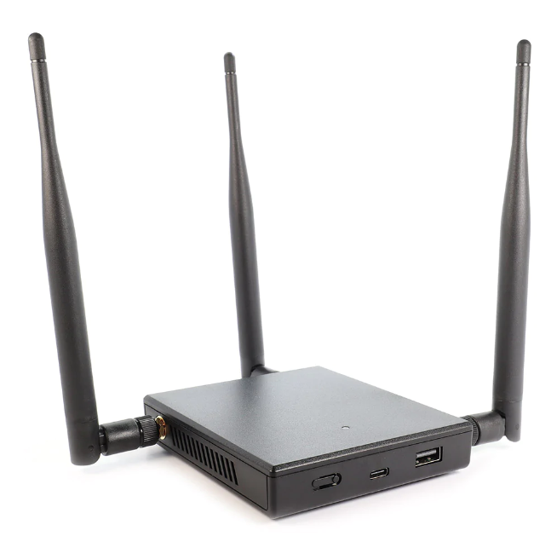

Slide 11
Hak5
WiFi Pineapple
$119.99
“WiFi Auditor”
Can spy on nearby WiFi users

Slide 12
What Can We Do?
Use a VPN app on your laptop
VPN = Virtual Private Network
Your connection will now be encrypted

Slide 13
Which VPN?
IVPN
TunnelBear
ExpressVPN

Slide 14
9. USE A VPN

Slide 15
8

Slide 16
How Many Ads on nytimes.com?
5

Slide 17
Worst Problem of Online Ads?
Annoying
Slows down website appearance
Can infect your PC

Slide 18
What Can We Do?
Use an Ad-Blocker app
Ublock Origin

Slide 19
8. Use an Ad Blocker

Slide 20
7

Slide 21
def add(x, y):
return x + y
def subtract(x, y):
return x - y
def multiply(x, y):
return x * y
def divide(x, y):
return x / y
print("Select operation.")
print("1.Add")
print("2.Subtract")
print("3.Multiply")
print("4.Divide")
while True:
# take input from the user
choice = input("Enter choice(1/2/3/4): ")
# check if choice is one of the four options
if choice in ('1', '2', '3', '4'):
try:
num1 = float(input("Enter first number: "))
num2 = float(input("Enter second number: "))
except ValueError:
print("Invalid input. Please enter a number.")
continue
if choice == '1':
print(num1, "+", num2, "=", add(num1, num2))
elif choice == '2':
print(num1, "-", num2, "=", subtract(num1, num2))
elif choice == '3':
print(num1, "*", num2, "=", multiply(num1, num2))
elif choice == '4':
print(num1, "/", num2, "=", divide(num1, num2))
# check if user wants another calculation
# break the while loop if answer is no
next_calculation = input("Let's do next calculation? (yes/no): ")
if next_calculation == "no":
break
else:
print("Invalid Input")

Slide 22
def add(x, y):
return x + y
def subtract(x, y):
return x - y
def multiply(x, y):
return x * y
def divide(x, y):
return x / y
print("Select operation.")
print("1.Add")
print("2.Subtract")
print("3.Multiply")
print("4.Divide")
while True:
# take input from the user
choice = input("Enter choice(1/2/3/4): ")
# check if choice is one of the four options
if choice in ('1', '2', '3', '4'):
try:
num1 = float(input("Enter first number: "))
num2 = float(input("Enter second number: "))
except ValueError:
print("Invalid input. Please enter a number.")
continue
if choice == '1':
print(num1, "+", num2, "=", add(num1, num2))
elif choice == '2':
print(num1, "-", num2, "=", subtract(num1, num2))
elif choice == '3':
print(num1, "*", num2, "=", multiply(num1, num2))
elif choice == '4':
print(num1, "/", num2, "=", divide(num1, num2))
# check if user wants another calculation
# break the while loop if answer is no
next_calculation = input("Let's do next calculation? (yes/no): ")
if next_calculation == "no":
break
else:
print("Invalid Input")

Slide 23
def add(x, y):
return x + y
def subtract(x, y):
return x - y
def multiply(x, y):
return x * y
def divide(x, y):
return x / y
print("Select operation.")
print("1.Add")
print("2.Subtract")
print("3.Multiply")
print("4.Divide")
while True:
# take input from the user
choice = input("Enter choice(1/2/3/4): ")
# check if choice is one of the four options
if choice in ('1', '2', '3', '4'):
try:
num1 = float(input("Enter first number: "))
num2 = float(input("Enter second number: "))
except ValueError:
print("Invalid input. Please enter a number.")
continue
if choice == '1':
print(num1, "+", num2, "=", add(num1, num2))
elif choice == '2':
print(num1, "-", num2, "=", subtract(num1, num2))
elif choice == '3':
print(num1, "*", num2, "=", multiply(num1, num2))
elif choice == '4':
print(num1, "/", num2, "=", divide(num1, num2))
# check if user wants another calculation
# break the while loop if answer is no
next_calculation = input("Let's do next calculation? (yes/no): ")
if next_calculation == "no":
break
else:
print("Invalid Input")

Slide 24
The Google Chrome Web Browser
Millions of lines of computer code
Some lines can be mistakes
Mistakes can give access to hackers

Slide 25
Fixing the Problem
Google constantly checks for mistakes
Fixes each mistake when found
Offers updates that will fix the problem

Slide 26
Meanwhile, in Romalvania ...
Hackers watch for these updates
Design programs to exploit the mistake
Prey upon people who don’t update

Slide 27
What Can We Do?
Be sure your programs are up to date
Use auto-update features if available

Slide 28
7. Keep your Programs up to date

Slide 29
6

Slide 30
What’s Better Than a Password?
A Password
And Something Else
Called “Two-Factor Authentication”

Slide 31
Second Factors
Message sent to your cellphone
An Authenticator app on your phone
An Authenticator dongle
A list of one-time emergency passwords

Slide 32
6. Use Two-Factor Authentication

Slide 33
5

Slide 34
What Do You Post on Facebook?
Birthdates
Relatives’ names
Children’s names
Pets’ names
Vacations
TMI

Slide 35
What’s the Problem?
Hackers can access social media
Can develop profiles of you
Can possibly guess passwords
Spoof messages from relatives
Rob your home when you are away

Slide 36
What Can We Do?
Have fun on Social Media
But limit the personal info you share

Slide 37
5. Be wary of Social Media

Slide 38
4

Slide 39
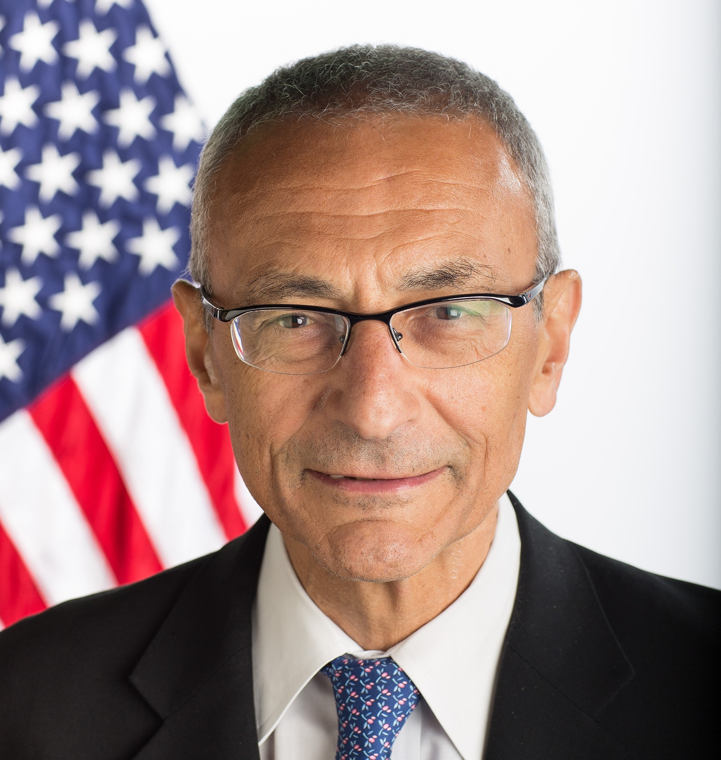
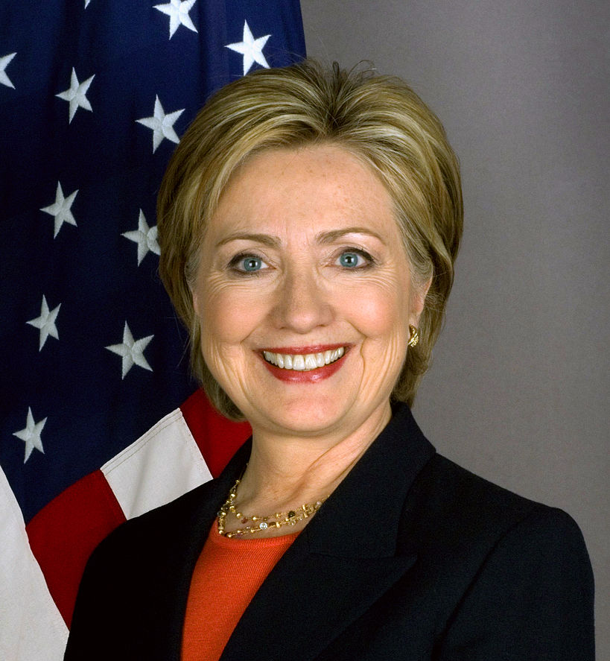
John Podesta
Hillary Clinton
Notes:
Because someone’s email account was hacked, an entire election may have been lost.

Slide 40
Anything wrong with this email?

Slide 41
From: Google <no-reply@accounts.googlemail.com
Date: March 19, 2016 at 4:34:30 AM EDT
To: jpodesta@gmail.com
Subject: *Someone has your password*
Someone has your password
Hi John
Someone just used your password to try to sign in to your account jpodesta@gmail.com.
Details:
Saturday, 19 March, 8:34:30 UTC
IP Address: 134.249.139.239
Location: Ukraine
Google stopped this sign-in attempt. You should change your password immediately.
CHANGE PASSWORD https://bit.ly/1PibSU0
Best,
The Gmail Team
Notes:
Copy of the actual phishing attempt sent to John Podesta.

Slide 42
Subject: Re: Some has your password
Sara,
This is a legitimate email. John needs to change his password immediately and ensure that two-factor authentication is turned on his account.
He can go to this link: https://myaccount.goog.e.com/security to do both. It is absolutely imperative that this is done ASAP.
If you or he has any questions, please reach out to me at 410-562-9762.
NOT
Notes:
Faulty response to John Podesta’s staff from the Democratic Party IT staff.

Slide 43
From: Google <no-reply@accounts.googlemail.com
Date: March 19, 2016 at 4:34:30 AM EDT
To: jpodesta@gmail.com
Subject: *Someone has your password*
Someone has your password
Hi John
Someone just used your password to try to sign in to your account jpodesta@gmail.com.
Details:
Saturday, 19 March, 8:34:30 UTC
IP Address: 134.249.139.239
Location: Ukraine
Google stopped this sign-in attempt. You should change your password immediately.
CHANGE PASSWORD https://bit.ly/1PibSU0
Best,
The Gmail Team
Notes:
Copy of the actual phishing attempt sent to John Podesta.

Slide 44
“Phishing”
Fake Email or Web sites
Tricks Internet users to reveal:
Credit card, Social Security numbers, etc.

Slide 45
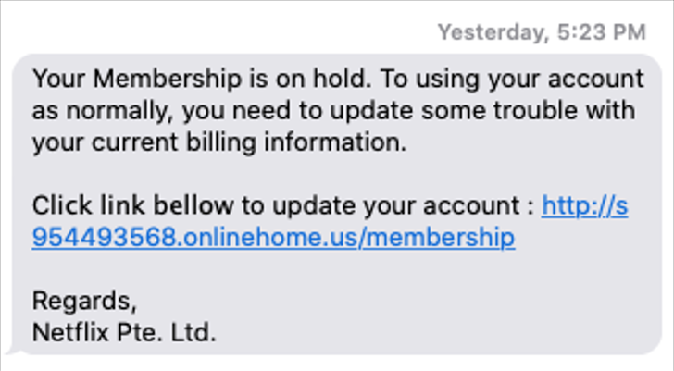
Is This Text Message From Netflix?

Slide 47
4. Be suspicious

Slide 48
3

Slide 49
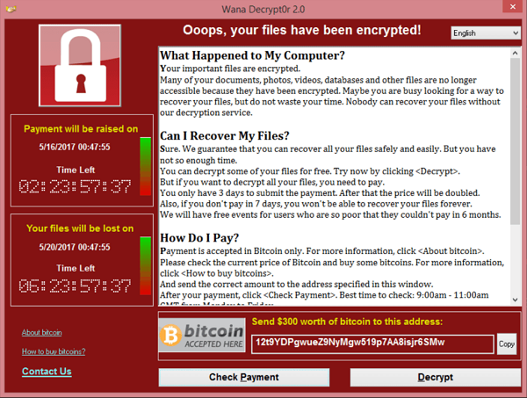

Slide 52
What Happened?
A ransomware has infected your PC
Encrypted all your data
You must pay to get your data back

Slide 53
A Better Alternative
Ignore the ransom threat
Use the data you backed up

Slide 54
Backups Save Us From:
Ransomware or Virus attacks
Lost or stolen laptops
Fire or flood damage
Accidental data erasures

Slide 55
What Can We Do?
Use an external hard drive
About $70 at Staples/Amazon
Use an Online Backup service
E.g., Carbonite, about $70/year
Use both

Slide 56
3. Back up your data

Slide 57
2

Slide 58
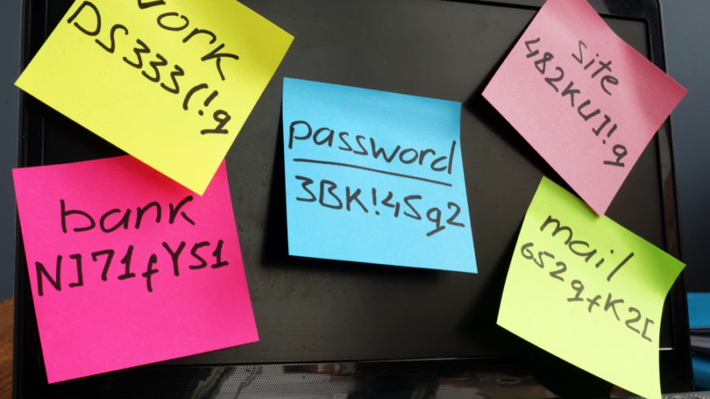
How Do You Keep Track of Your Passwords?

Slide 59
Notes:
Be careful where you write down passwords
Hawaii’s missile alert agency – note the yellow Post-It note

Slide 60
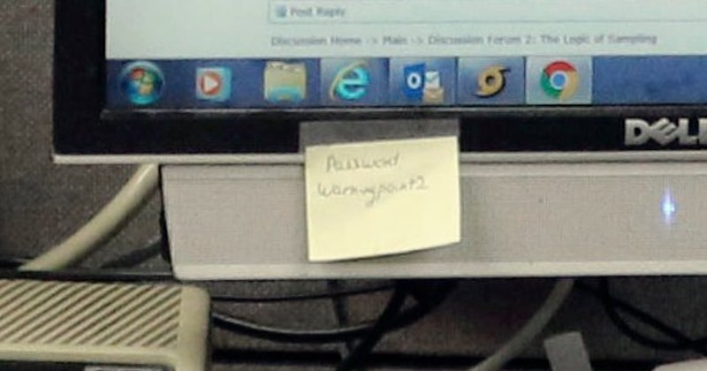
Notes:
Looks like: Warningpoint2

Slide 61
How Many Passwords Do You Have?
~100

Slide 62
Where Do You Store Your Passwords?
Sheets of paper
Notebook
My computer
In Email messages

Slide 63
What Can We Do?
Use a Password Manager
Examples:
1Password
Dashlane
LastPass

Slide 64
What Do Password Managers Do?
Store all your passwords online
Enter passwords into forms automatically
Only you can access them
Company does not store your password
“Zero Knowledge Architecture”

Slide 65
For Extra Security ...
For really important accounts ($$$):
Add a nonsense character at end
Or leave off a character
Even if hackers break into your password vault
They still cannot access your key accounts

Slide 66
2. Use a Password Manager

Slide 67
10 Ways to Protect Yourself Online
10. Use Mobile Devices
9. Use a VPN
8. Use an Ad-Blocker
7. Keep Your Programs Up to Date
6. Use Two-Factor Authentication
5. Be Wary of Social Media
4. Be Suspicious
3. Back Up Your Data
2. Use Password Manager

Slide 68
1

Slide 69
What Is Your First and Often Only Defense Against Hackers?
PASSWORDS

Slide 70
Top Ten Passwords at Adobe

Slide 71
A Strong Password
Think of a strong password, but easy to remember
Write it down

Slide 72
Is Your Password Strong?
Password strength tests:
www.grc.com/haystack.htm
www.PasswordMeter.com

Slide 73
What Is a Strong Password?
At least 14 characters
Include different characters:
Capitals, Numbers, Symbols
Randomly chosen
Avoid common words, dates, names
Change the password regularly

Slide 74
Can You Remember This Password?
4Sa7ya,ofbfotc
4 Score and 7 years ago, our forefathers brought forth on this continent
Notes:
What’s even better than a strong password?

Slide 75
Some Major Data Breaches
JP Morgan Chase 2014 76 Million
Equifax 2017 146 Million
Adult Friend Finder 2016 412 Million
Marriott 2018 500 Million
Facebook 2021 530 Million
LinkedIn 2021 700 Million
Yahoo! 2016 3,000 Million
Notes:
As of Nov 2018. Also, Anthem, 80 Million; and Adult Friend Finder, 412 Million
Even if we are very careful, hackers may still be able to get our passwords from the companies we deal with.
From: NY Times and CNN

Slide 76
Companies Will Be Hacked
We can’t control that
What does that mean?
A Different Password for Each Account

Slide 77
Strong Passwords: Summary
At least 14 characters
Include different characters
Randomly chosen
Unique

Slide 78
Which Accounts Need $trong Passwords?
Banking / Finance
Retailers
Email

Slide 79
Why Protect Email?
Email may be a backdoor to your other accounts

Slide 80
Anything Easier than Passwords?

Slide 81
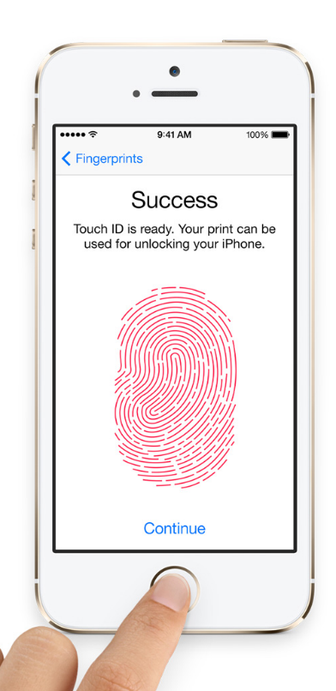
Biometric Authentication
Reads:
Fingerprint
Face pattern
Patterns in eye
Voice patterns
Convenient but secure
Still need password as backup
Notes:
Mention ways to foil police searches

Slide 82
1. Use Strong Passwords

Slide 83
Recap

Slide 84
10 Ways to Protect Yourself Online
10. Use Mobile Devices
9. Use a VPN
8. Use an Ad-Blocker
7. Keep Your Programs Up to Date
6. Use Two-Factor Authentication
5. Be Wary of Social Media
4. Be Suspicious
3. Back Up Your Data
2. Use Password Manager
1. Use Strong Passwords

Slide 85
Handouts
Free Material Available:
A printable 2-page handout
A PDF copy of the slide show
Go to: bit.ly/secure-my-pc

Slide 86
Security: As Simple as ABC
Always Be Careful
Rich Malloy
Tech Help Today
Greenwich, CT
203-912-8268
malloy@techhelptoday.com

