Slide 1
Animated GIFs
Add Motion to Your Slides

Slide 2

Animated GIFs
Add Motion to Your Slides

Slide 3

Animated GIFs
Add Motion to Your Slides

Slide 4
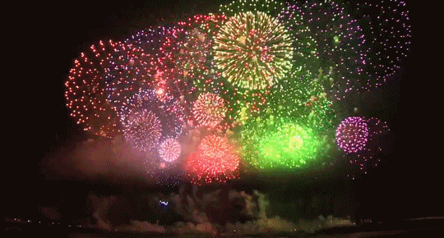
Animated GIFs
Add Motion to Your Slides

Slide 5
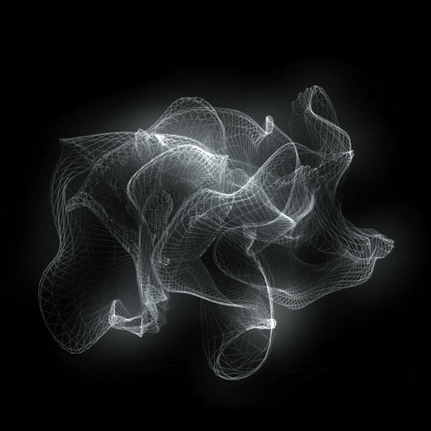
Animated GIFs
Add Motion to Your Slides

Slide 6
Animated GIFs
Add Motion to Your Slides

