Slide 1
Macros & VBA
Rich Malloy, Tech Help Today
Advanced Microsoft Excel
Session 5:
© 2019, Tech Help Today LLC

Slide 2
What Is a Macro?
A “macro-instruction”
A sequence of instructions
Designed to automate a process
Can perform time-consuming procedures automatically

Slide 3
What Is VBA?
Visual Basic for Applications
Programming language used by macros
Used by all Office applications
Word
Excel
PowerPoint

Slide 4
What Can a Macro Do?
Insert boilerplate text
Jump to another location/worksheet
Automate repetitive operations
E.g., Same procedure has to be done in 10 different workbooks

Slide 5
What Can VBA Do?
Everything Macros can do, plus:
Automate complex procedures
Create custom functions
Create custom commands
Create a simple “front-end” for fool-proof data entry

Slide 6
How to Create a Macro
Two ways:
Record it
With the Developer Tab
Write it in the VB Editor

Slide 7
Developer Tab
Used to create and edit macros
Normally hidden from users

Slide 8
Developer Tab
Not normally visible
To view it:
Right-click any tab (e.g., Home)
Choose: Customize the Ribbon…
On right, check: Developer
Click OK

Slide 9
VB Editor
Tool for editing macros
Can also run macros
Can help “debug” a macro
To view the VB Editor:
Click: Developer > Visual Basic
Or: Alt + F11

Slide 10
Where to Store a Macro
Two Places:
Current workbook
Macro works only when this workbook is open
Personal Macro Workbook
Hidden workbook, opens automatically
Macros will work with all your workbooks
But, will not “travel” with workbooks

Slide 11
How to Run a Macro
Four ways:
Select a shortcut key combination
Assign a macro to a button
Assign a macro to Quick Access Toolbar
Run the macro from the VB Editor

Slide 12
Create a Macro
A Macro to Insert My Name
Click: Developer > Record Macro
Set Macro name: InsertMyName
Set Shortcut key: N [Shift + N]
Click: OK
Enter your name
Enter your company below it
Click: Stop Recording

Slide 13
Run the Macro
Press: Ctrl + Shift + N
Problem:
Macro always puts company name in the same cell

Slide 14
“Use Relative References” ?
Default setting: Off
I.e., Macro will use Absolute References
It will work on the cell selected when the macro was created
Click to turn on
Now macro will work on any cell

Slide 15
Create a Macro
A Macro to Insert My Name Anywhere
Click: Developer > Record Macro
Set Macro name: InsertMyNameAnywhere
Set Shortcut key: A [Shift + A]
Click: OK
Click: Use Relative References
Type your name
Press: Ctrl + Enter
Click: Stop Recording

Slide 16
How to Edit a Macro
Easy: Remove and re-record it
Hard: Edit the VBA code

Slide 17
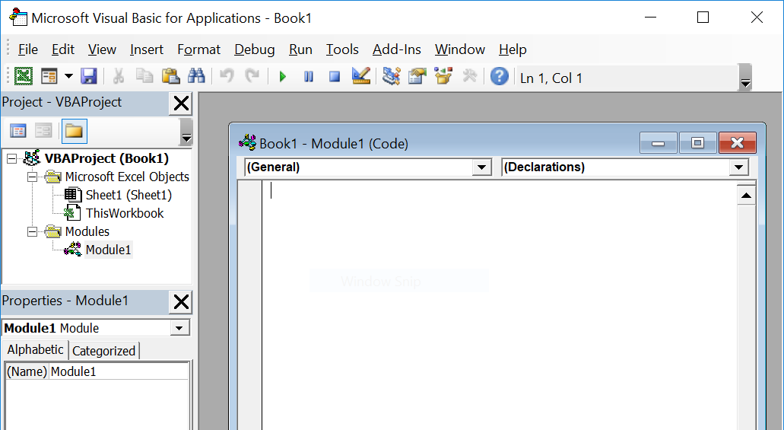
The VB Editor
For editing macros and procedures

Slide 18
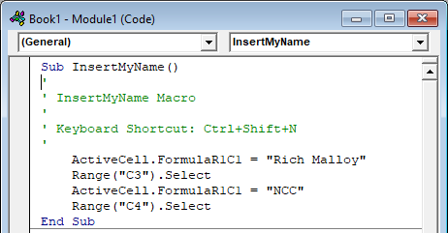
Code for a Simple Macro

Slide 19
Code for a Simple Macro
Sub: Subprocedure
Name of Macro
Comments
Instruction code
End of procedure

Slide 20
Code for the First Macro
Absolute References

Slide 21
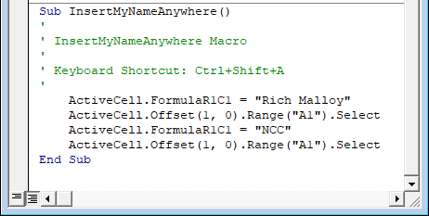
Code for the Second Macro
A Relative Reference
Move Down 1 Row

Slide 22
Watch Code Being Created
Open both Excel and VB Editor
Click: Developer > Visual Basic
Put them side by side
In Excel, record a macro
Watch code appear in VB Editor

Slide 23
Create a Macro
Create a Macro to set cell as Bold
Watch code being created
Execute Macro by clicking Run button

Slide 24
Create a Macro
Create a Macro to:
Set cell as Bold
Center text in cell
Note the With statement

Slide 25
Set Several Properties at Once
The With Statement
Example:
With ActiveCell.Font
.Name = "Calibri"
.Size = 16
.Underline =
End With

Slide 26
Beyond Macros
Macros are useful
But to really get things done, we need to use VBA

Slide 27
VBA
Macros on Steroids!
Visual Basic for Applications

Slide 28
VBA Code
Viewed in the VBA Editor
Code is stored in a Module
Organized into Sub procedures and Functions

Slide 29
How VBA Views a Workbook
A Workbook is a set of Objects
Examples:
Application
Workbooks("Book1.xlsx")
Worksheets("Sheet1")
Range("C3")
Cells(2,3)
Worksheets("Sheet2").Range("D3")

Slide 30
How VBA Refers to Cells
Selection
Whichever cell is selected
Range("C3")
Cell C3
Cells(2,4)
Cell D2
Worksheets("Sheet2").Range("D3")
Cell D3 on Sheet2

Slide 31
VBA Objects
Are Hierarchical
Workbook contains Worksheets contains Ranges
Have Properties
E.g.: Column width, Font Color
Have Methods
E.g.: Clear, Check spelling, Copy

Slide 32
VBA Objects Are Hierarchical
Objects can include other objects:
Worksheet > Range > Value
ActiveCell > Font > Color
Example:
Worksheets("Sheet1").Range("A1")._ Value = "Test"

Slide 33
Objects have Properties
Bold, Font Color, Borders
Examples:
Range("C1").Font.Bold = True
Selection.Font.Color = vbBlue
Cells(3,3).Borders(xlEdgeBottom)_.Weight = xlThick

Slide 34
Visual Basic Constants
Use instead of numerical values
Easier to specify Properties
Examples:
vbBlue = FF0000
xlThick = 4

Slide 35
Objects Also Have Methods
Copy, Paste, Merge, etc.
Examples:
Range("A1").Copy
Worksheets("Sheet1").Paste
Selection.Merge

Slide 36
Object-Oriented Programming
Old Style:
Do something to something
Copy Range("D3")
Object-Oriented Approach
Tell the object to do something
Range("D3").Copy

Slide 37
Create a VBA Macro
Goal:
A Macro that will insert blank rows above all cells in Column A that are Bold
Strategy:
Start with a simple macro
Gradually enhance it

Slide 38
Create a Macro
Create a Macro to:
Insert a Row above the current cell
Move down 2 rows

Slide 39
Edit a Macro
Edit the previous Macro to:
Insert a row, only if the cell is Bold

Slide 40
If This, Then That
The If Statement
If This, then That, else Another, end
Example in English:
If the selected cell is bold, Then
Insert a row above the cell
Move down two rows
Else
Move down one row
End If

Slide 41
If This, Then That
Example in VBA Code:
If Selection.Font.Bold = True Then
Selection.EntireRow.Insert
ActiveCell.Offset(2, 0).Select
Else
ActiveCell.Offset(1, 0).Select
End If

Slide 42
Edit a Macro
Edit the previous Macro to:
Insert a row if cell is bold
Move down to next row
Repeat 100 times

Slide 43
Loops: Shampoo, Rinse, Repeat
Loops repeat a number of times
Example in English:
For I = 1 to 100
If selected cell is bold Then
Insert row above cell
Move down two rows
Else
Move down one row
End If
Next I

Slide 44
Loops
Example in VBA Code:
For I = 1 to 100
If Selection.Font.Bold = True
Selection.EntireRow.Insert
ActiveCell.Offset(2, 0). Select
Else
ActiveCell.Offset(1, 0). Select
End If
Next I

Slide 45
Create a Macro
Create a Macro to:
Delete the current row

Slide 46
Edit a Macro
Edit the previous Macro to:
Delete the current row …
If the first cell is blank
Else move down one row

Slide 47
Solution
If Selection = "" Then
Selection.EntireRow.Delete
Else
ActiveCell.Offset(1,0).Select
End If

Slide 48
Edit a Macro
Edit the previous Macro to delete all blank rows:
Delete the current row …
If the first cell is blank
Repeat 100 times

Slide 49
Solution
For i = 1 To 100
If Selection = "" Then
Selection.EntireRow.Delete
Else
ActiveCell.Offset(1, 0).Select
End If
Next i

Slide 50
Run the Macros from Buttons
Add two buttons to run the macros
Click: Developer > Insert
Use Form Controls
Active X Controls are more complex

Slide 51
Form Controls
Various tools on the Developer Tab:
Buttons
Checkboxes
Slidebars
Text boxes
List boxes
Combo boxes

Slide 52
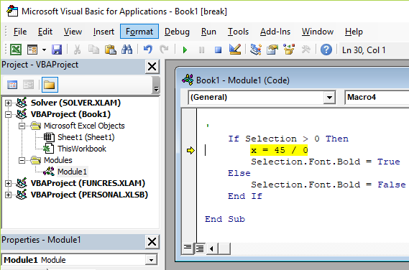
Bugs Happen – The Debug Mode
Click: Reset

