Slide 1
Dashboards & Power BI
Rich Malloy, Tech Help Today
Advanced Microsoft Excel
Session 5:

Slide 2
Review: Excel Tables
Great Formatting
Great Functionality
Used by many new Excel features

Slide 3
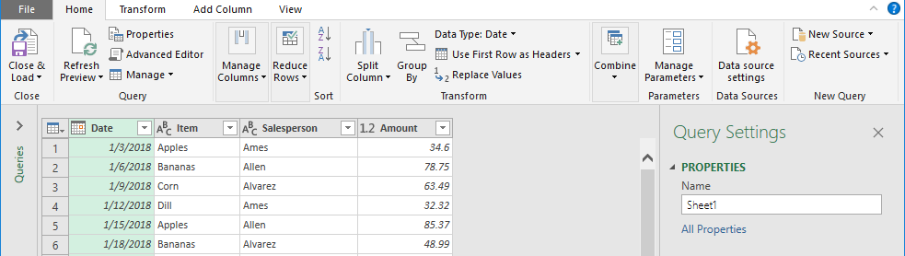
Review: Get & Transform
Alias: Power Query
Enables you to set up a query
Query can get data
And then reorganize it
Notes:
An alternative to Get & Transform is what we will talk about in this session

Slide 4
Agenda
Map Charts
3D Map Charts
Interactive Dashboard w/ Timeline
Power BI Desktop Dashboard
Macros
VBA

Slide 5

Map Charts
Feature available in certain Excel versions
Shows images of states

Slide 6
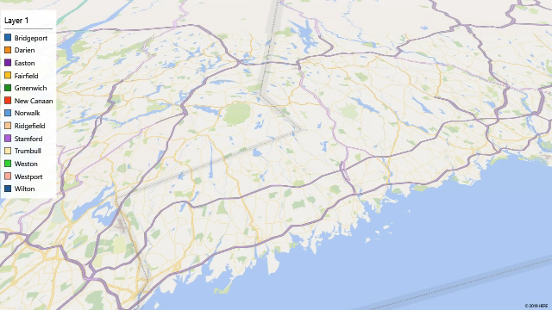
3D Maps Chart
Shows geographical data in 3D
Also animated
Examples: Sales for Each City

Slide 7
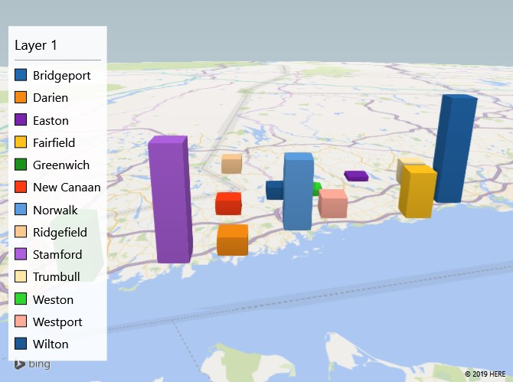
3D Map: Population in SE CT Towns

Slide 8
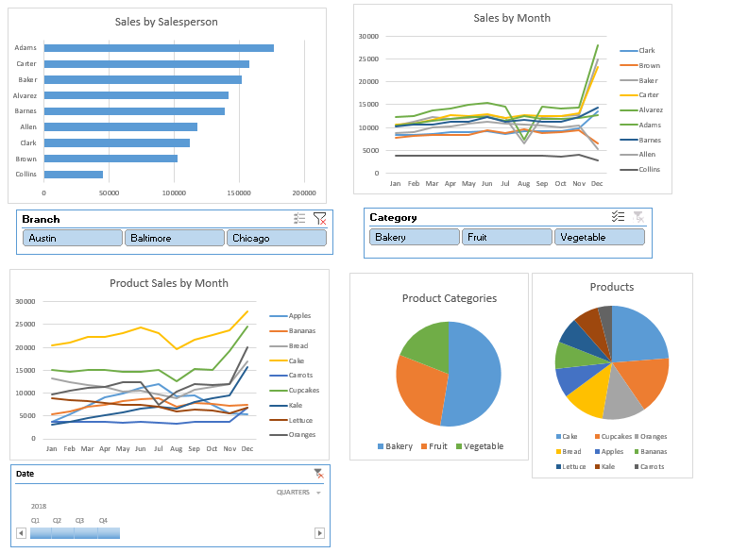
Interactive Dashboard
Lets executives focus on key variables

Slide 9
Create an Interactive Dashboard
General Procedure:
Create a Pivot Table
Create Slicers based on the table
Make copies of the Pivot Table
Adjust each copy to show different insight
Create Pivot Charts from each table

Slide 10
Power View Dashboard
Had some amazing features, but…
Power View has been deprecated by Microsoft
Replaced by Power BI Desktop

Slide 11
Power BI Desktop
Free dashboard tool from Microsoft
How to download:
  Go to the following website:
    https://powerbi.microsoft.com/en-us/desktop/
  Click: Advanced Download Options
  Click: Download
  Choose: PBIDesktop.msi
  Click: Next
  If needed, enter your name and email address
  The program should then download

Slide 12

Power PI Desktop Demo

Slide 13
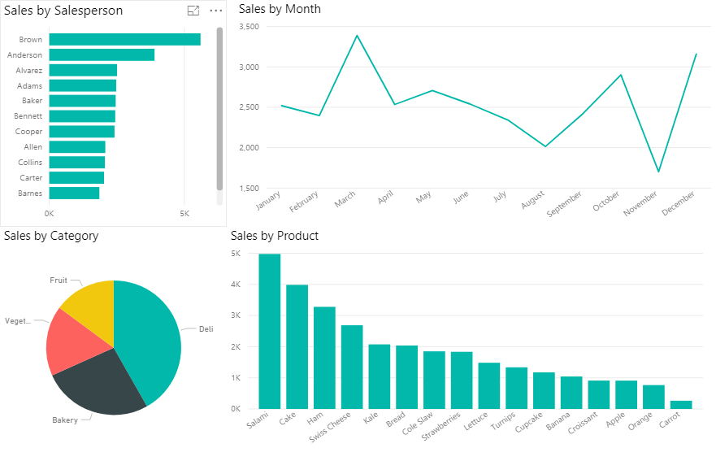
The Power BI Desktop Dashboard
To filter the charts, just click any chart element (e.g., pie slice)

